Slide 1




Predictions for the FIFA World Cup Qatar 2022
Jeza Allohibi

Slide 2
Outline
Introduction
Exploratory Data Analysis
Model building
Prediction & Reality
Conclusion

Slide 3


FIFA World Cup - History
The first ever FIFA World Cup goes back to 1930.
The 1930s FIFA World Cup edition consisted of only thirteen teams invited by the organization.
FIFA World Cup Trophy 1974-Present
Jules Rimet Trophy
1930-1970

Slide 4
Project Road Map
Data Acquisition
Data Preparation and wrangling
Exploratory Data Analysis
Group stage/knockout modeling
Group stage/knockout prediction

Slide 5
Datasets
In this project, three datasets were used. The first two are only for general EDA. The third one is for EDA, constructing the models, and predicting the matches.
World
cups
Wc
matches
International
matches

Slide 6




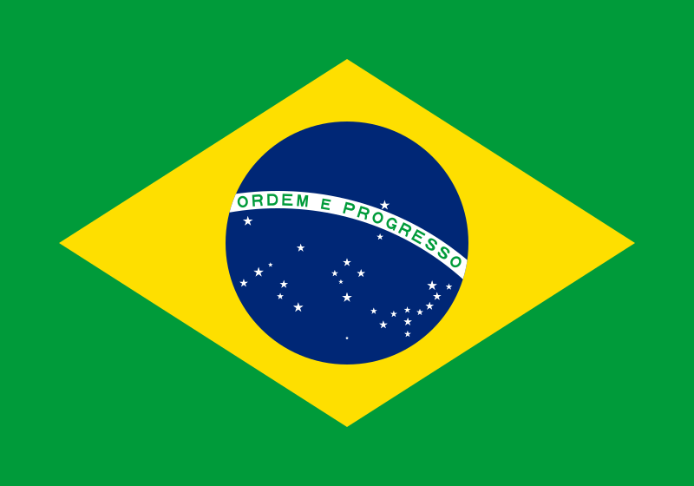

Exploratory Data Analysis
Most World Cup Winners
4
Italy
2
France
3
Germany
2
Uruguay
5
Brazil
2
Argentina

Slide 7
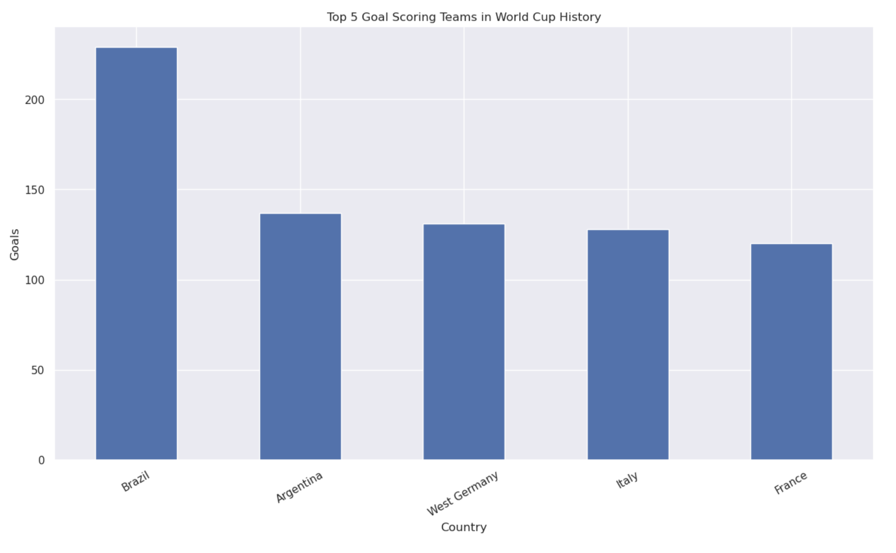
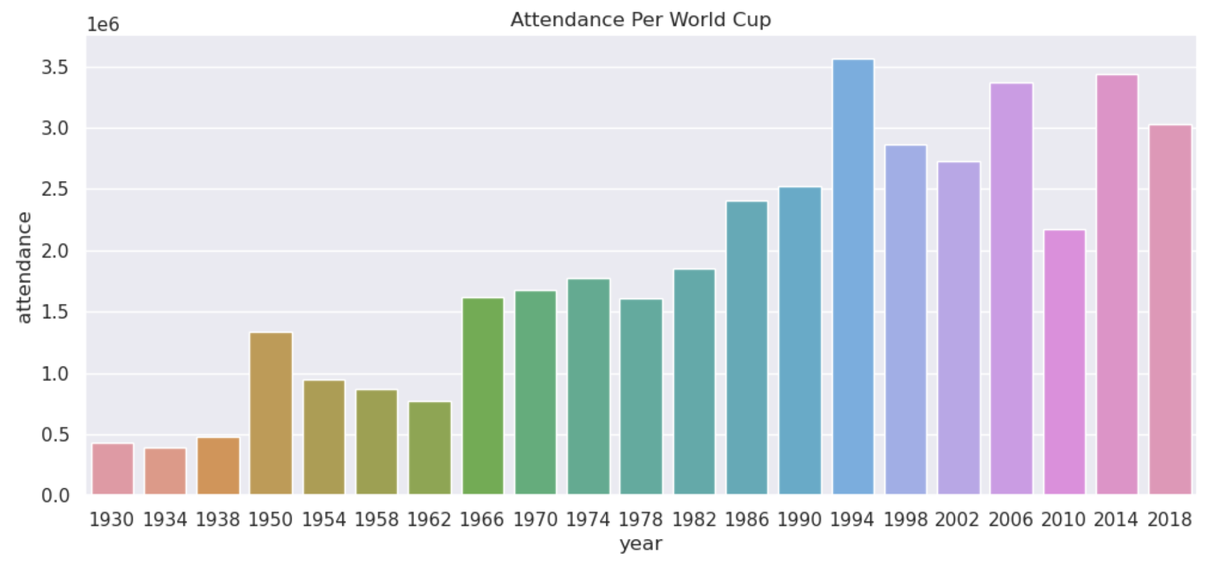
Exploratory Data Analysis

Slide 8
Exploratory Data Analysis
Team | Date | Rank
Brazil | 2022-06-06 | 1
Belgium | 2022-06-14 | 2
France | 2022-06-13 | 3
Argentina | 2022-06-05 | 4
England | 2022-06-14 | 5
Italy | 2022-06-14 | 6
Spain | 2022-06-12 | 7
Portugal | 2022-06-12 | 8
Mexico | 2022-06-14 | 9
Netherlands | 2022-06-14 | 10
Team | Date | Rank
Croatia | 2022-06-13 | 16
Morocco | 2022-06-13 | 24
Canada | 2022-06-13 | 38

Slide 9
Data Preparation and Feature Engineering
Dropping unnecessary columns
Creating training dataset.
Data Splitting
Filter the teams participating in World cup 2022
and creating Group stage dataset
Creating "Last_Team_Scores" dataset

Slide 10














32 Participating Teams of FIFA 2022
Group A
Group B
Group C
Group D
Qatar
England
Argentina
France
Ecuador
IR Iran
Saudi Arabia
Australia
Senegal
USA
Mexico
Denmark
Netherlands
Wales
Poland
Tunisia

Slide 11













32 Participating Teams of FIFA 2022
Group E
Group F
Group G
Group H
Spain
Belgium
Brazil
Portugal
Costa Rica
Canada
Serbia
Ghana
Germany
Morocco
Switzerland
Uruguay
Japan
Croatia
Cameroon
Korea Republic

Slide 12
Training Data
23921 x 25
date | home_team | away_team
home_team_continent | away_team_continent | home_team_fifa_rank
away_team_fifa_rank | home_team_total_fifa_points | away_team_total_fifa_points
home_team_score | away_team_score | tournament
city | country | neutral_location
shoot_out | home_team_result | home_team_goalkeeper_score
away_team_goalkeeper_score | home_team_mean_defense_score | home_team_mean_offense_score
home_team_mean_midfield_score | away_team_mean_defense_score | away_team_mean_offense_score
away_team_mean_midfield_score

Slide 13
Final Training Data
9321 x 13
Team1 | Team2 | Team1_FIFA_RANK
Team2_FIFA_RANK | Team_Result | Team1_Goalkeeper_Score
Team2_Goalkeeper_Score | Team1_Defense | Team1_Offense
Team1_Midfield | Team2_Defense | Team2_Offense
Team2_Midfield

Slide 14
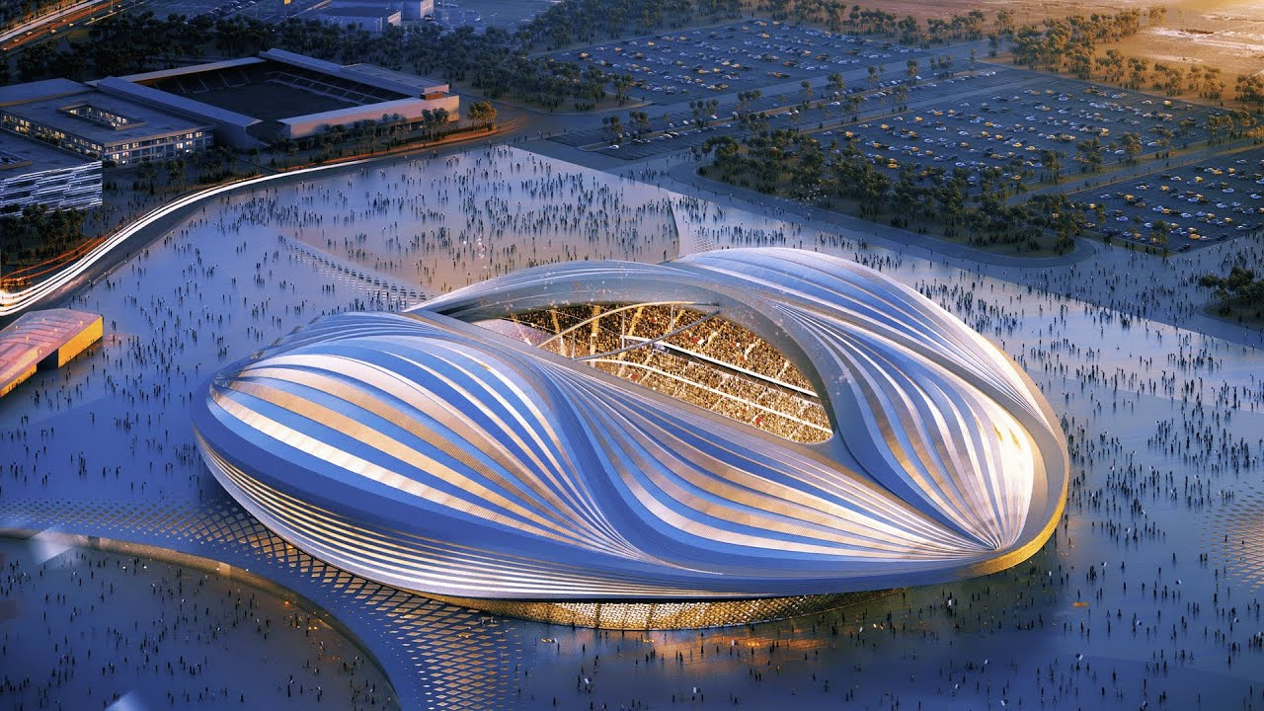
Machine Learning Models
Random Forest
XGBoost
Logistic Regression
Naive Bayes
Decision Tree

Slide 15
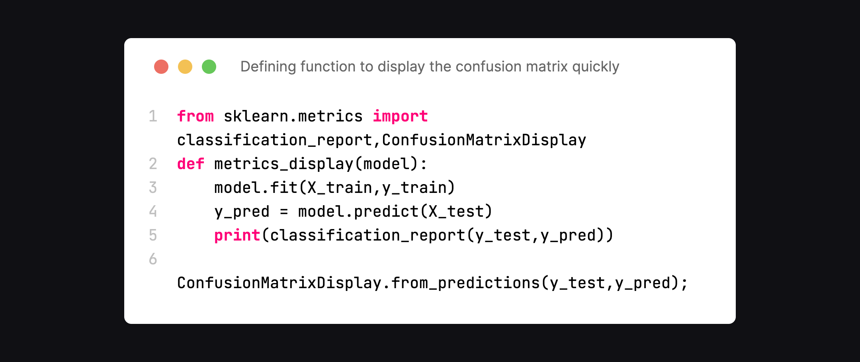
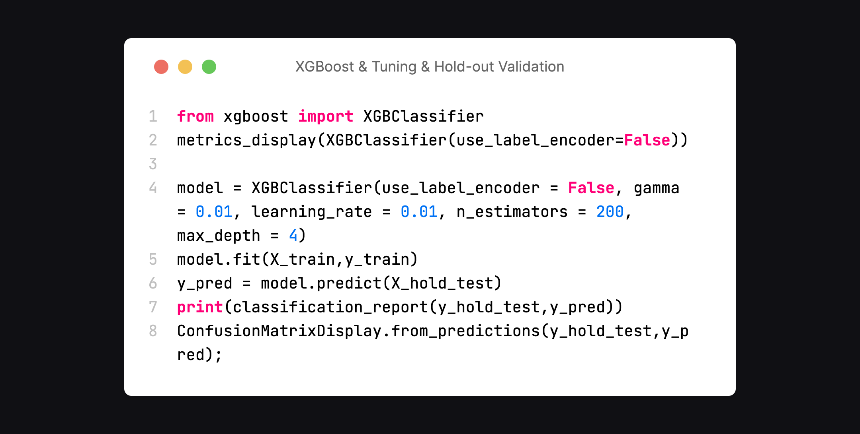
Code Snippets

Slide 16

Results & Final model
Model | Accuracy | Accuracy after tuning
Random Forest | 60% | 60%
XGBoost | 56% | 61%
Logistic Regression | 56%
Naive Bayes | 33%
Decision Tree | 51%

Slide 17
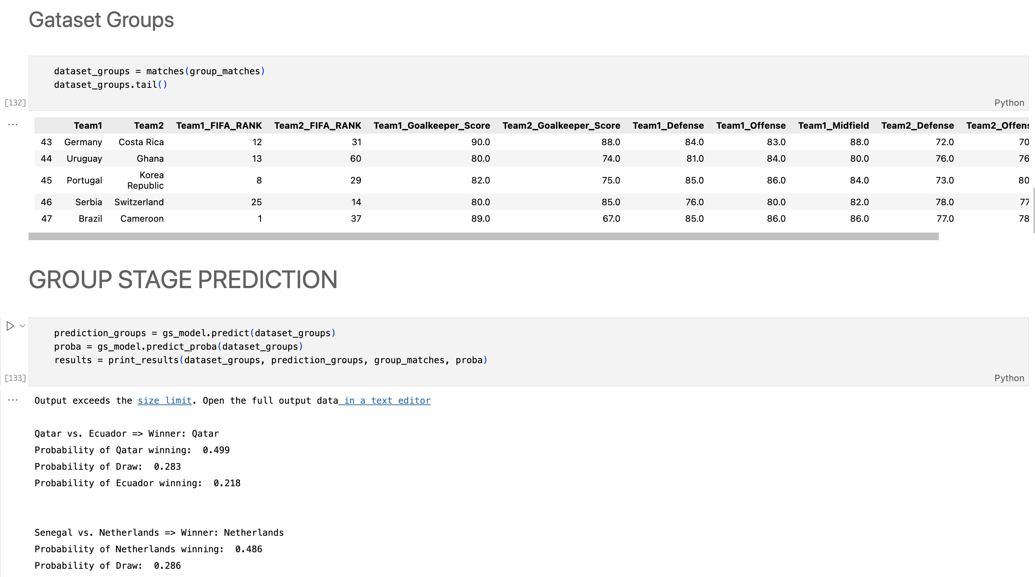
Code Snippets

Slide 18
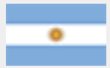



Group Stage Prediction
Prediction
Reality
Argentina
VS
Saudi Arabia
Argentina
VS
Saudi Arabia
Winner: Argentina (0.823)
Winner: Saudi Arabia
Switzerland
VS
Serbia
Switzerland
VS
Serbia
Winner: Switzerland (0.376)
Winner: Switzerland
Iran
VS
USA
Iran
VS
USA
Winner: USA (0.438)
Winner: USA

Slide 19
Group Stage Prediction
Draw | Morocco vs. Croatia => Winner: Croatia
 | Probability of Croatia winning: 0.439
 | Probability of Draw: 0.297
 | Probability of Morocco winning: 0.264
Morocco | Canada vs. Morocco => Winner: Morocco
 | Probability of Morocco winning: 0.599
 | Probability of Draw: 0.234
 | Probability of Canada winning: 0.167
Morocco | Belgium vs. Morocco => Winner: Belgium
 | Probability of Belgium winning: 0.576
 | Probability of Draw: 0.233
 | Probability of Morocco winning: 0.190
Prediction
Reality

Slide 20
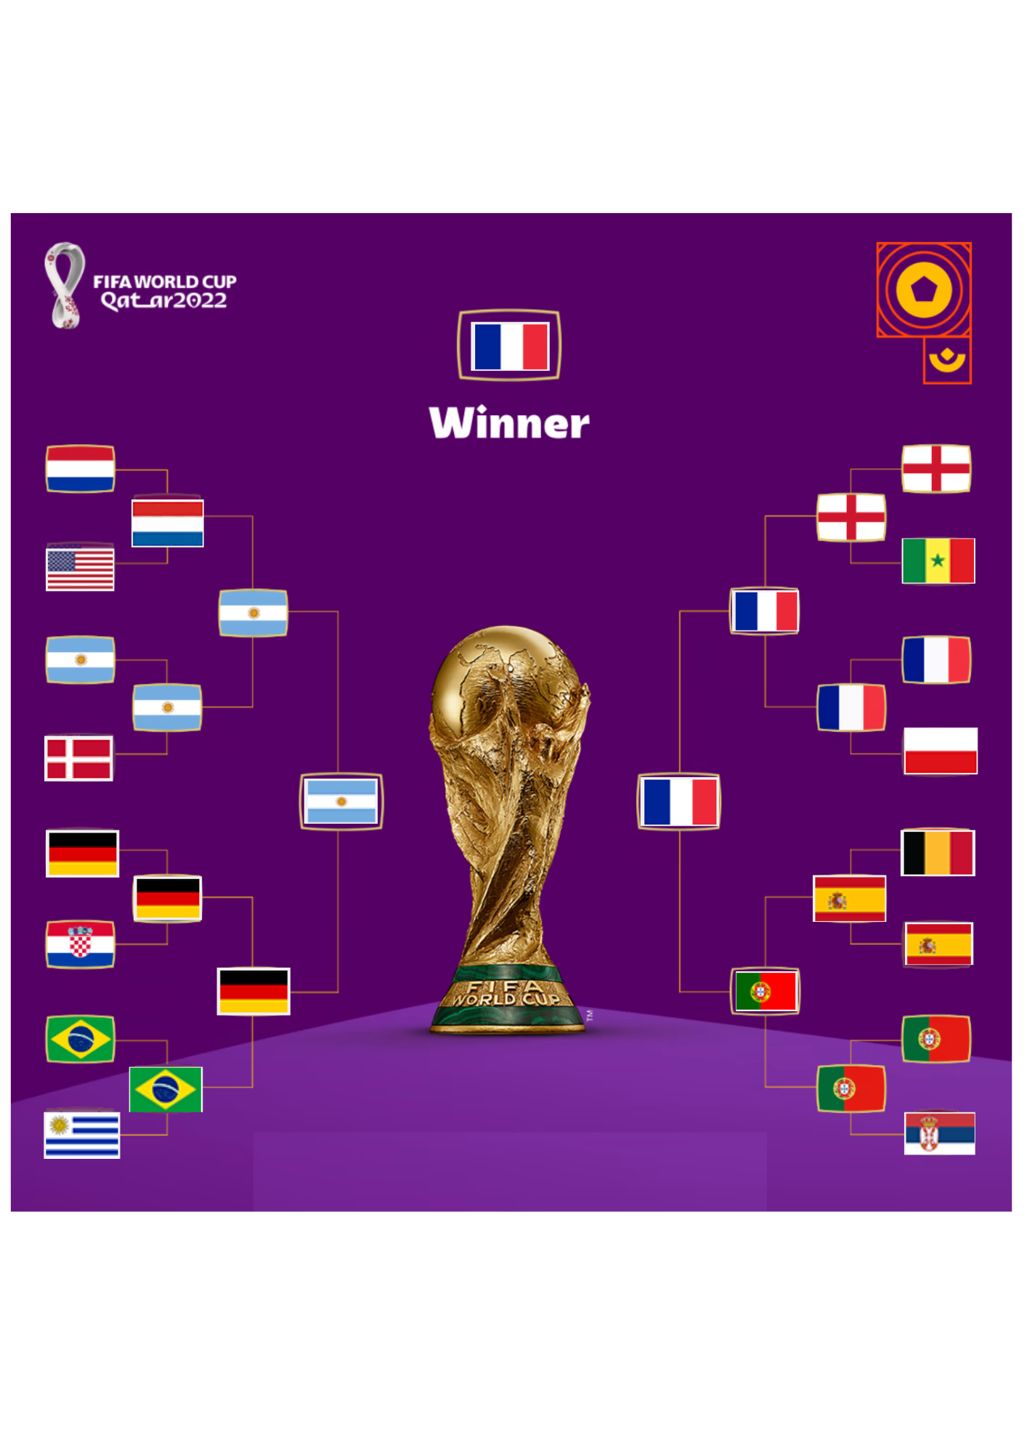
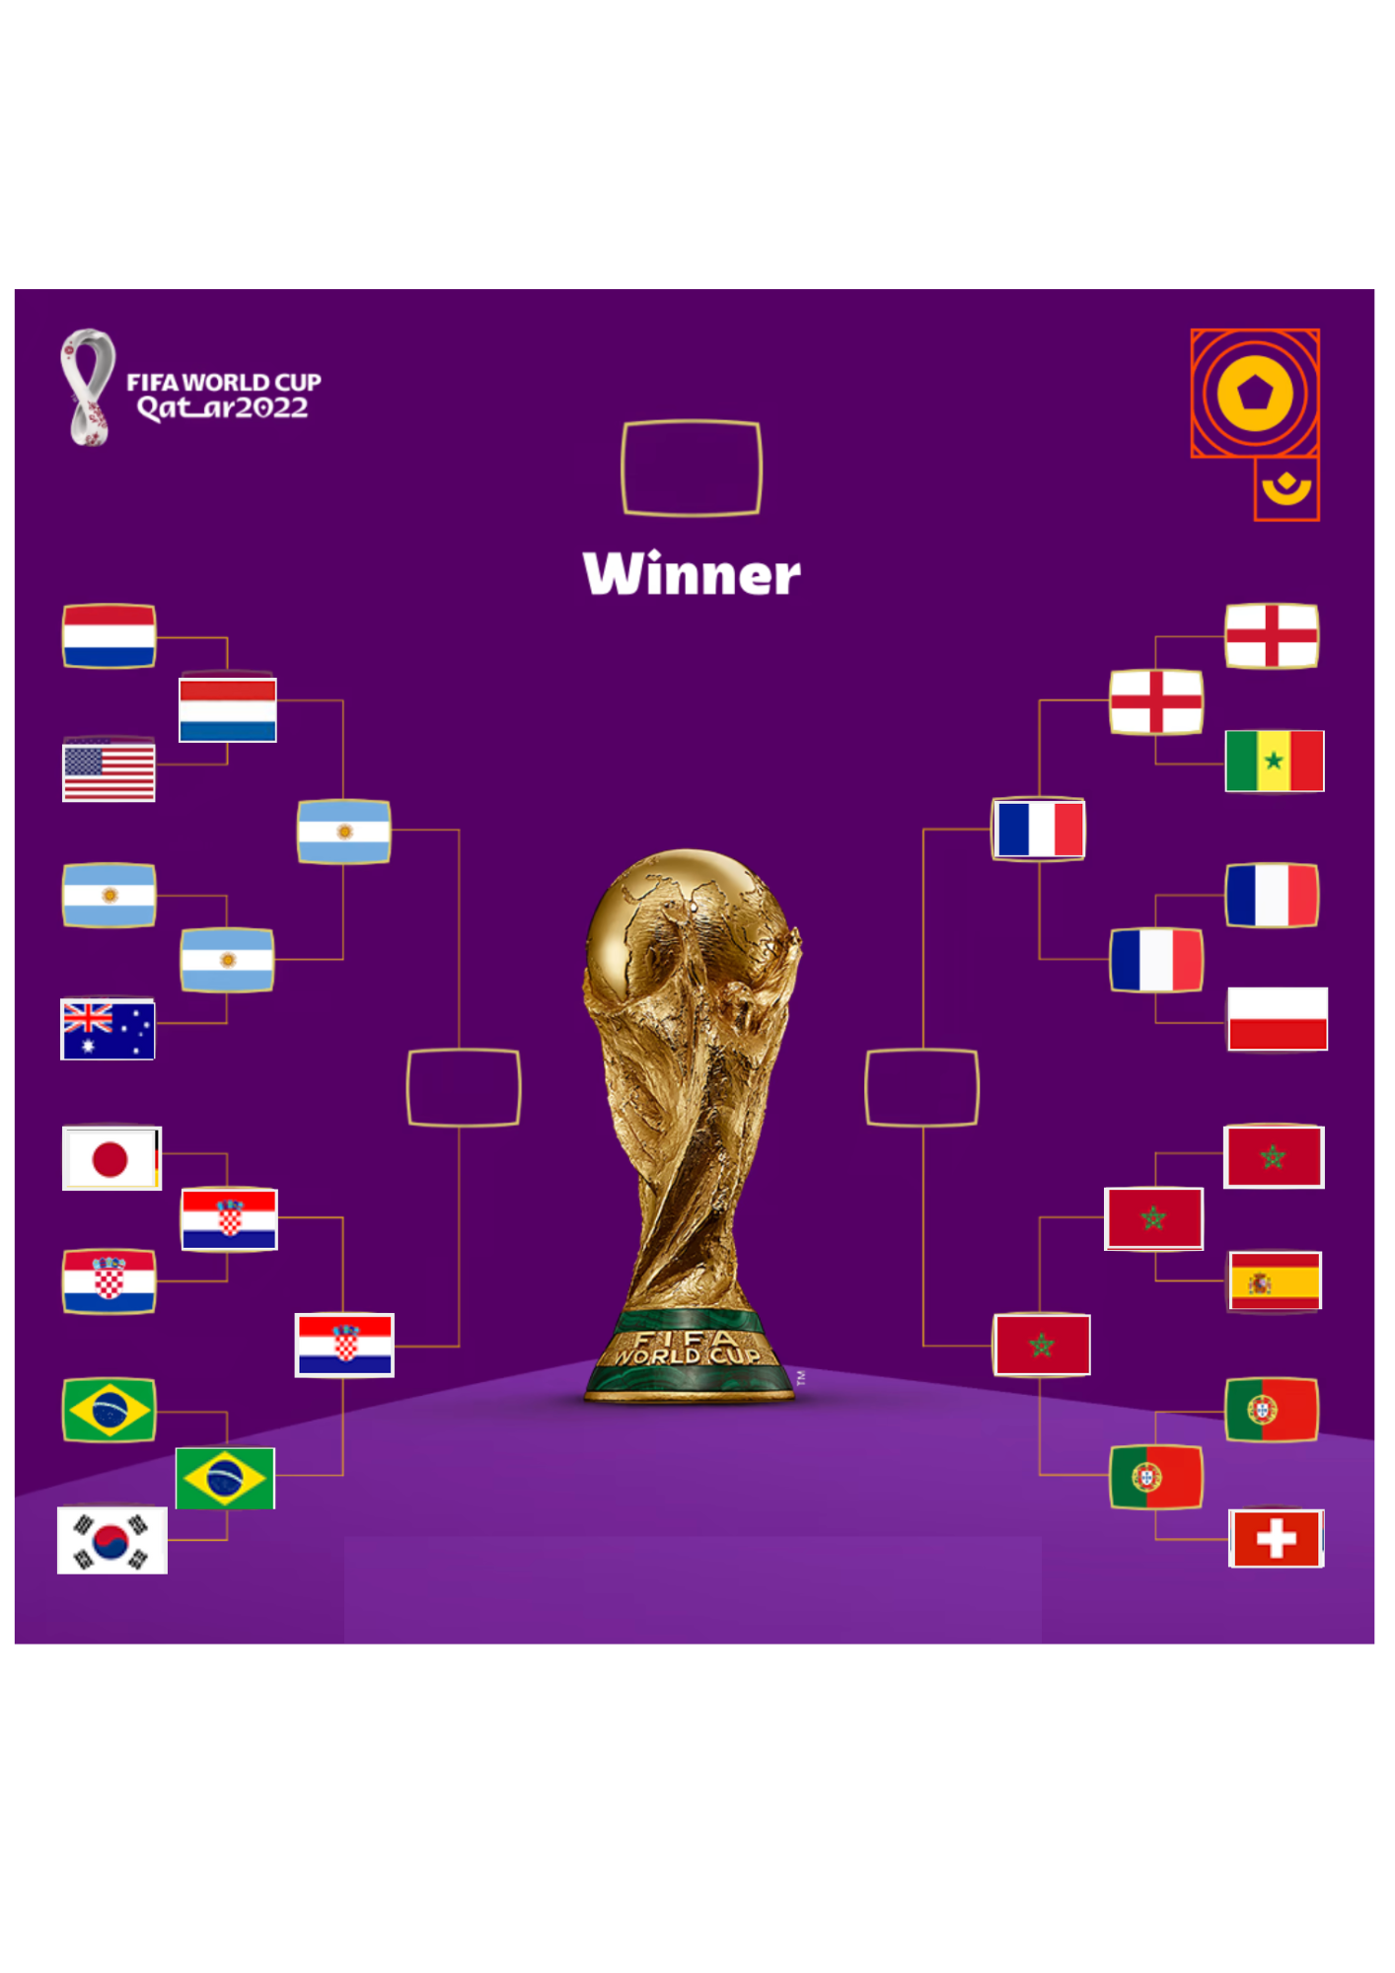
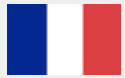
Knockout Prediction
Prediction
Reality
Winner: France (0.592)

Slide 21
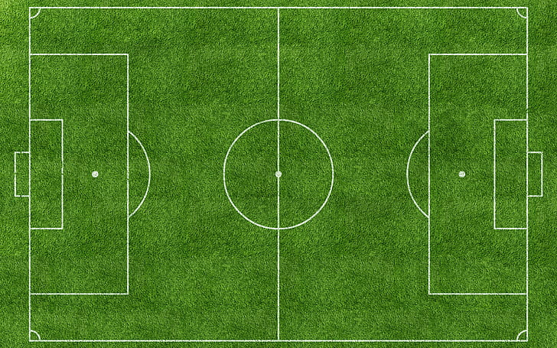

Conclusion
For anyone watching football, being able to predict matches is a key aspect of the hobby.
We’d expect a better team to have a better chance of winning than a worse team.
The accuracy of our predictions therefore relies on the accuracy of our judgement on team’s ability.
The prediction accuracy could be improved if more features are added.

Slide 22

References
https://www.kaggle.com/datasets/brenda89/fifa-world-cup-2022
https://www.kaggle.com/datasets/evangower/fifa-world-cup?select=wcmatches.csv
https://www.brendankent.com/blog/coding-for-sports-analytics-resources-to-get-started
https://www.bigbookofr.com/sport-analytics.html
https://www.robert-hickman.eu/post/dixon_coles_1/

Slide 23

Thank You!

